Slide 1
Generalized Update Process

Slide 2
Motivation
One structure to update the different blocks
One Update FIFO to configure all blocks consecutively
One standardized way to control

Slide 3
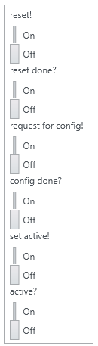
Control Cluster
Blocks have to enter reset state
Indication that reset is done
Blocks should enter update mode
Indication that the update has finished
All blocks should leave the update state
Any block still active? Not in idle?

Slide 4
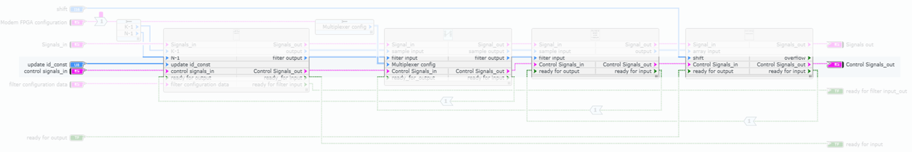
Daisy chaining
Signal is passed through all relevant blocks
Single input to feed the control data
Single output to observe the reaction

Slide 5
Signaling
Keep each signal high, until it is high at the output
Enter reset state immediately
E.g. indicates that FIFOs are emptied
Wait for current operation to be finished and enter update state
Block switches back to idle or active state
Leave the update state immediately
Keep low at the input – OR chain – If one block is active → output is active

Slide 6
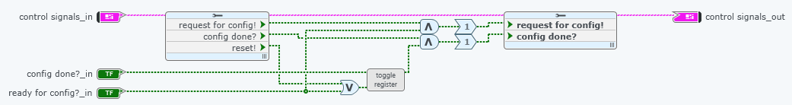
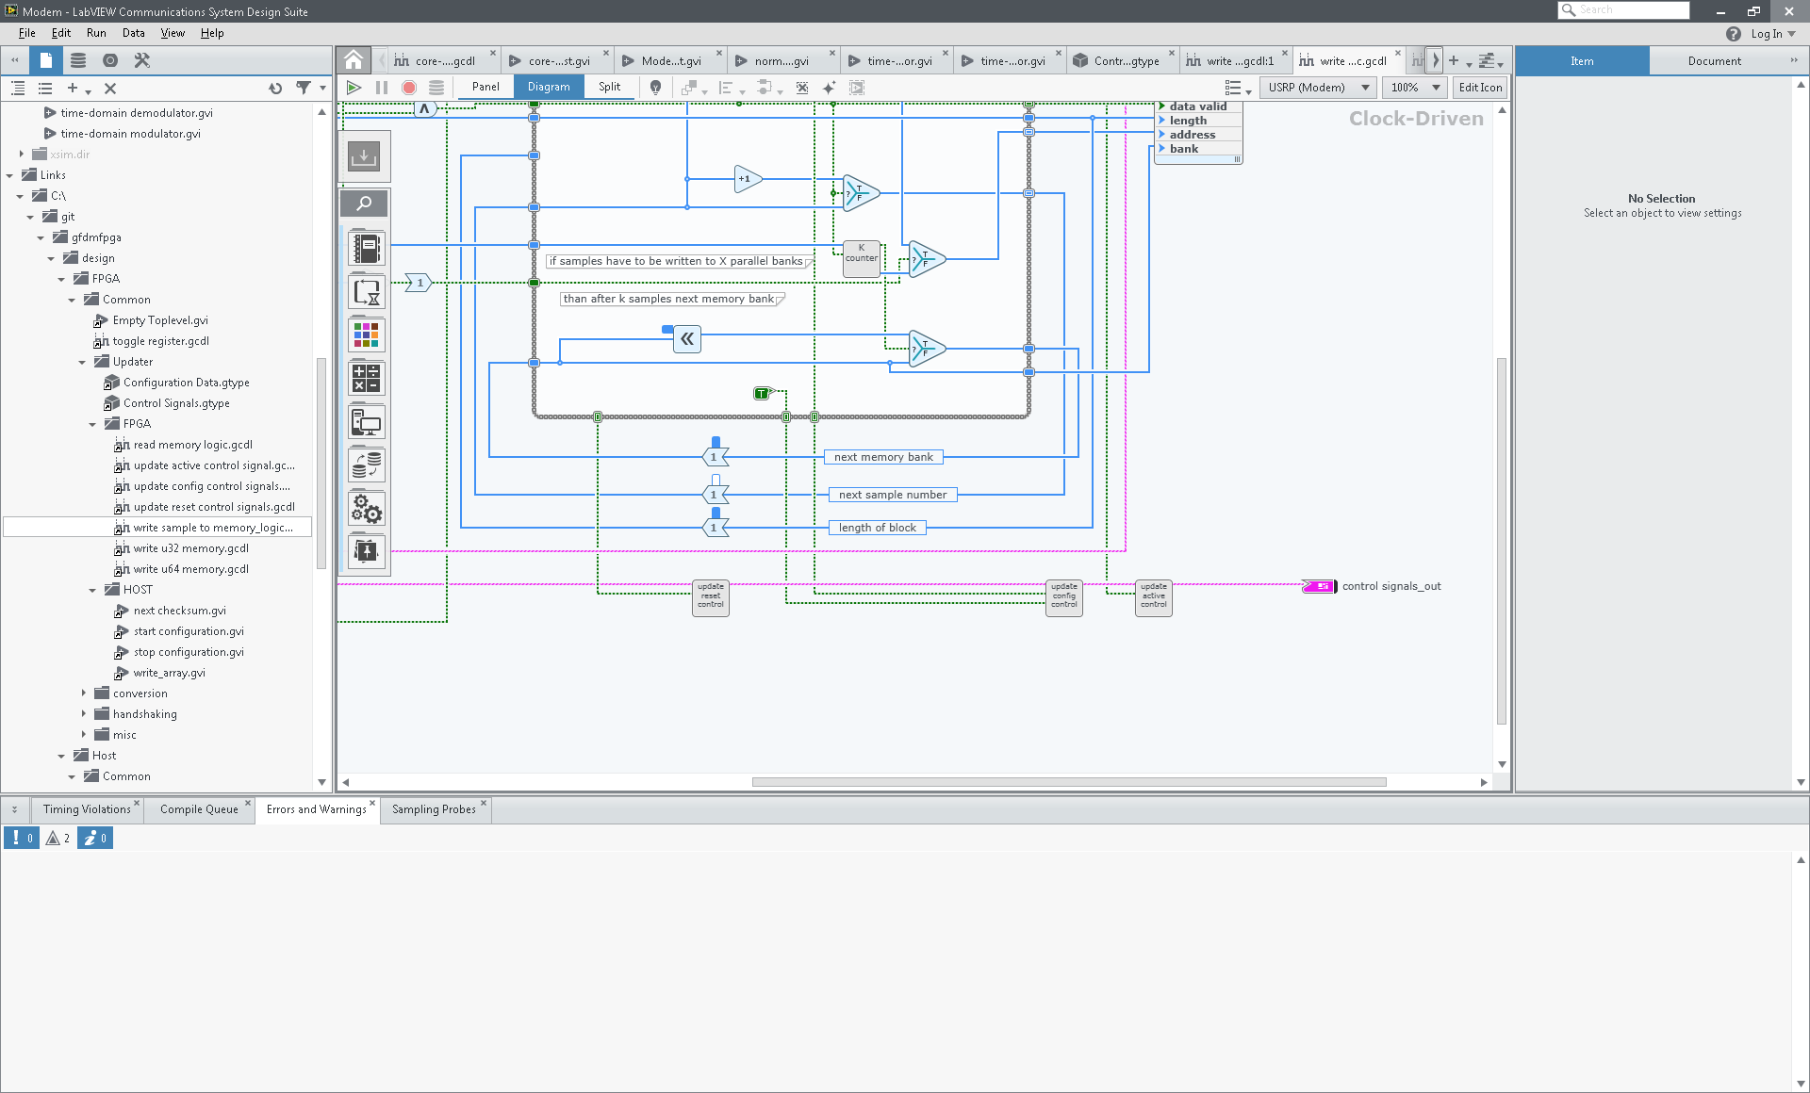
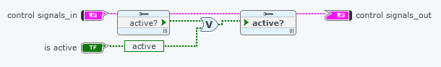
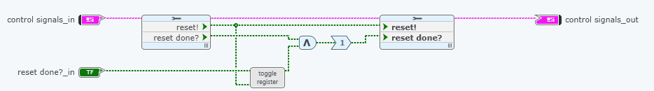
Blocks

Slide 7
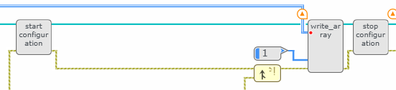
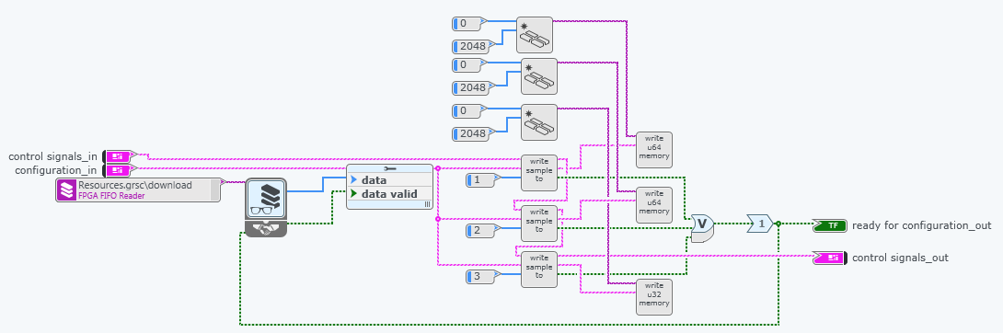
Update logic
Standardized process, independent of the respective module
Only one FIFO needed.

Slide 8
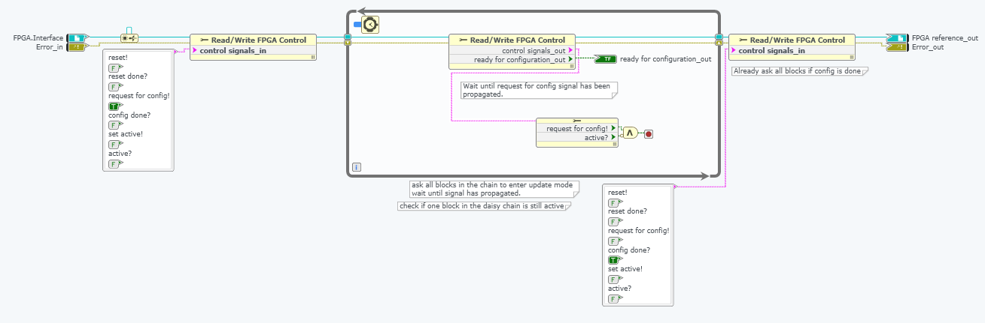
Start configuration
Blocks needs to run once
Ensures that FPGA is ready to accept data

Slide 9
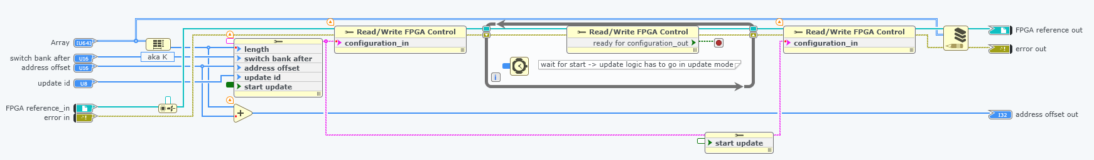
Write Array Host
Same block can configure different independent memories, e.g. modulator, resource mapper, …
Only the update ID constant needs to be specified prior
One unsigned 64 bit FIFO used
Address offset used to store several configuration inside the memory

Slide 10
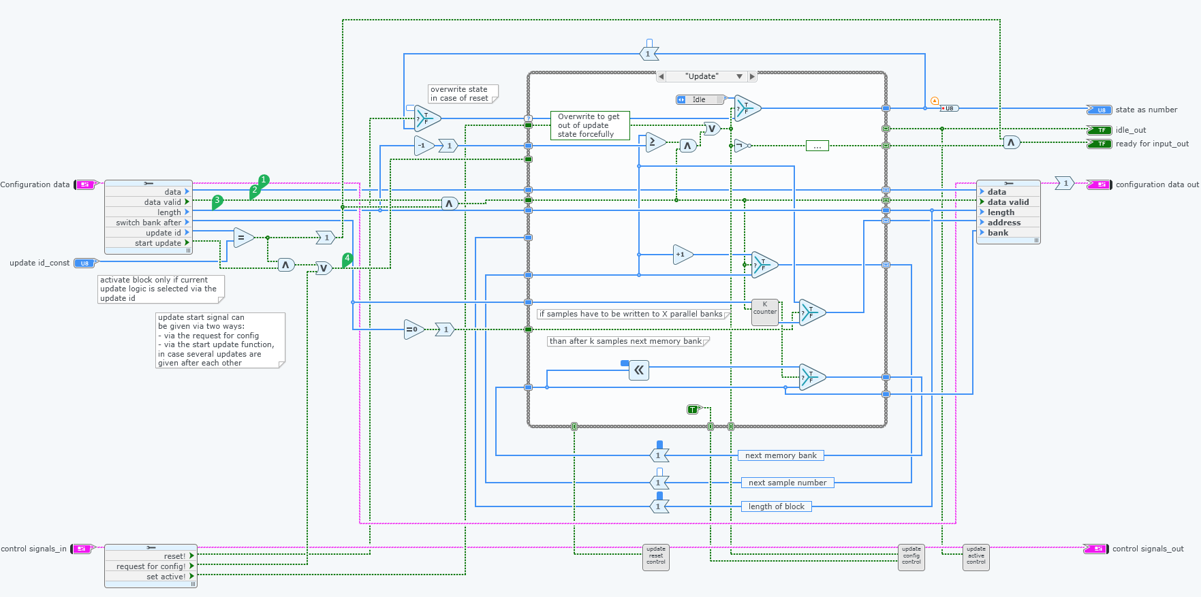
Write Array FPGA
Counter controls FIFO via the ready for input signal

Slide 11
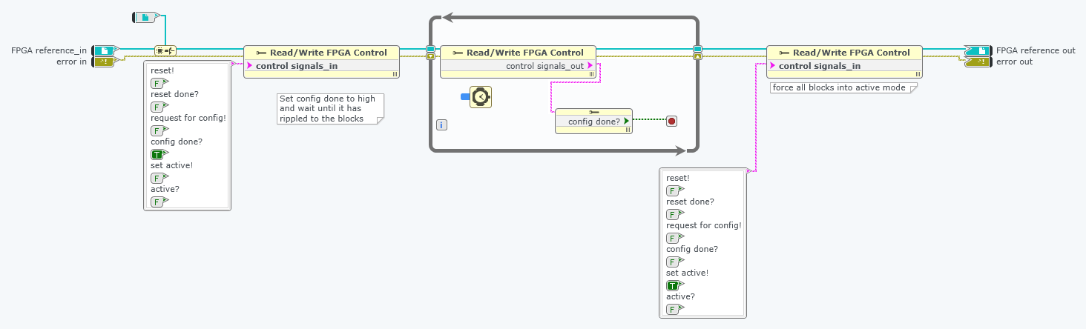
Stop configuration
Concludes the configuration process

Slide 12
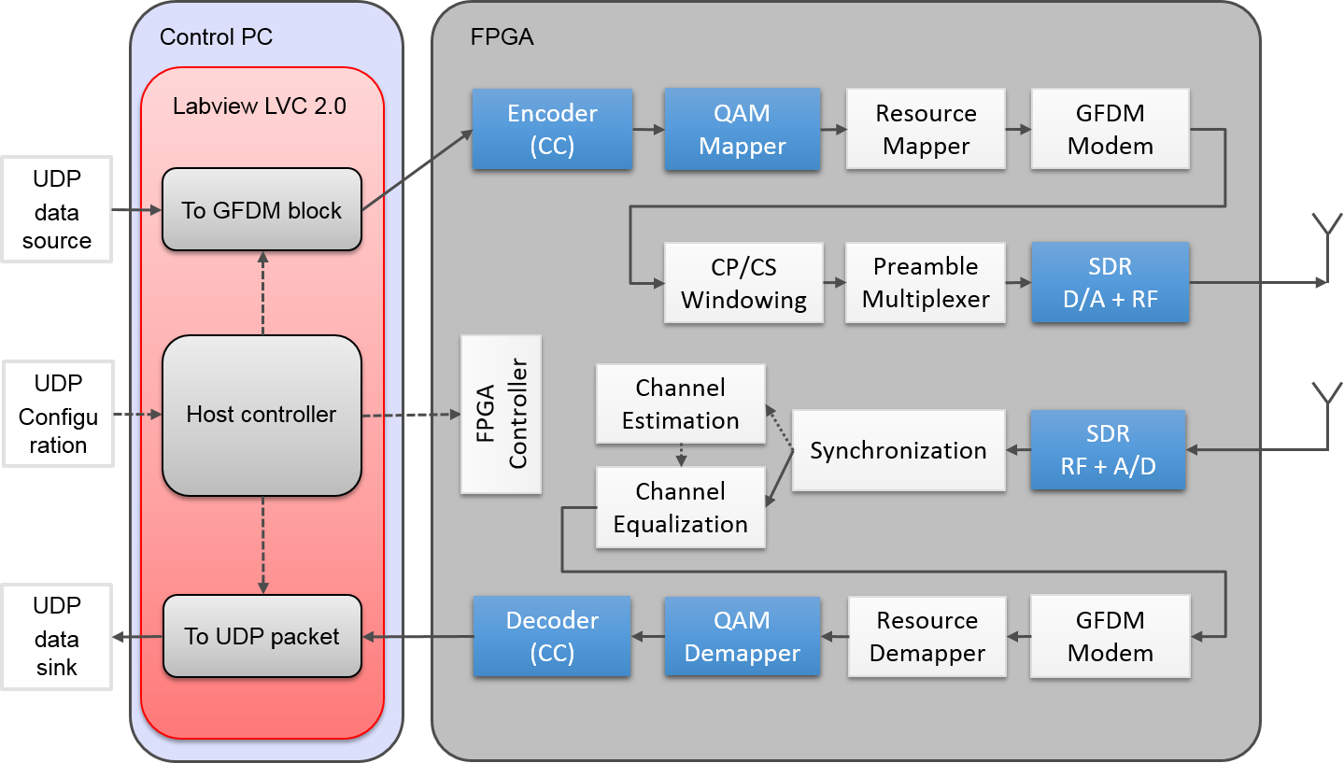
Block diagram of the GFDM transceiver

Slide 13
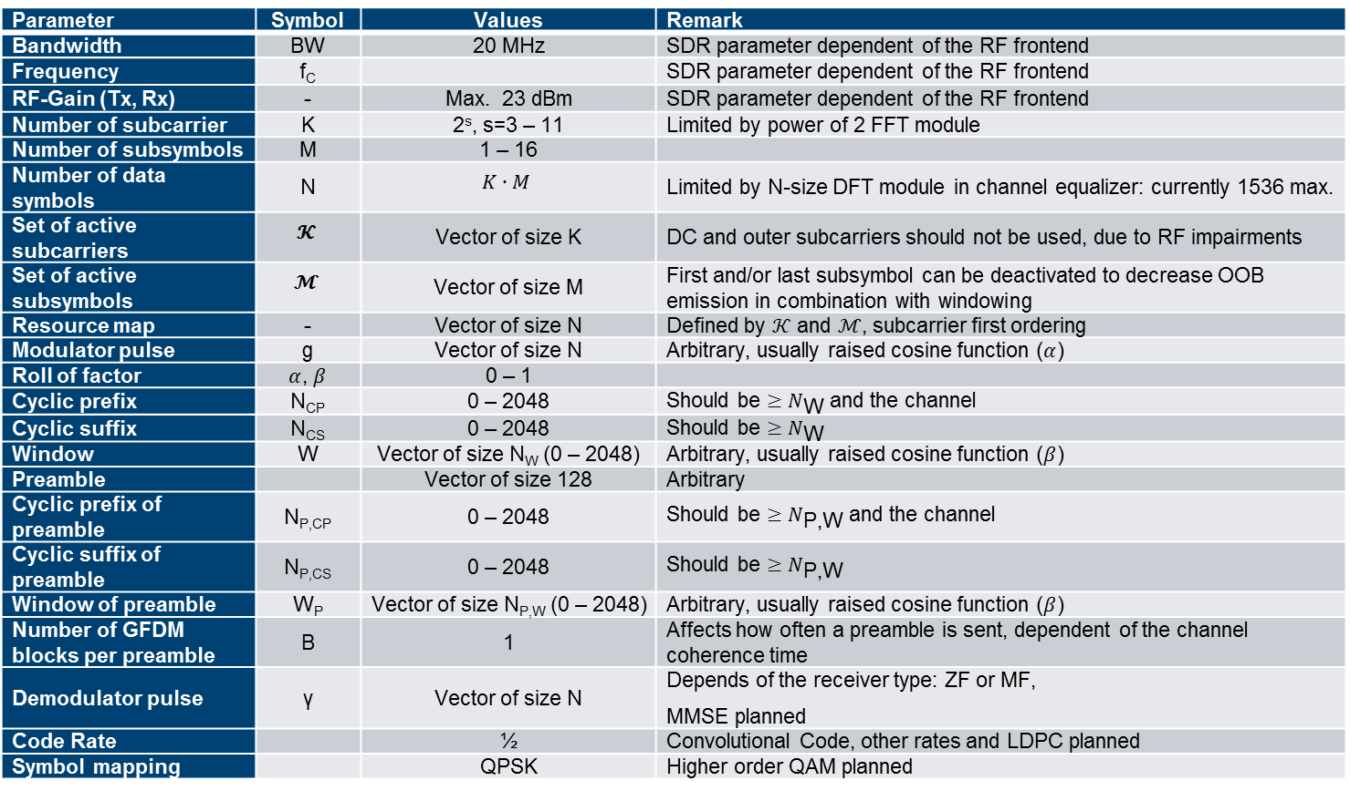
Configurable Parameters
Parameter | Symbol | Values | Remark
Bandwidth | BW | 20 MHz | SDR parameter dependent of the RF frontend
Frequency | f_{C} |  | SDR parameter dependent of the RF frontend
RF-Gain (Tx, Rx) | - | Max. 23 dBm | SDR parameter dependent of the RF frontend
Number of subcarrier | K | 2^{s}, s=3 – 11 | Limited by power of 2 FFT module
Number of subsymbols | M | 1 – 16
Number of data symbols | N | $$K∙M$$ | Limited by N-size DFT module in channel equalizer: currently 1536 max.
Set of active subcarriers | $$𝓚$$ | Vector of size K | DC and outer subcarriers should not be used, due to RF impairments
Set of active subsymbols | $$𝓜$$ | Vector of size M | First and/or last subsymbol can be deactivated to decrease OOB emission in combination with windowing
Resource map | - | Vector of size N | Defined by $𝒦$ and $ℳ$, subcarrier first ordering
Modulator pulse | g | Vector of size N | Arbitrary, usually raised cosine function ($α$)
Roll of factor | $α$, $β$ | 0 – 1
Cyclic prefix | N_{CP} | 0 – 2048 | Should be $≥N_{\text{W}}$ and the channel
Cyclic suffix | N_{CS} | 0 – 2048 | Should be $≥N_{\text{W}}$
Window | W | Vector of size N_{W} (0 – 2048) | Arbitrary, usually raised cosine function ($β$)
Preamble |  | Vector of size 128 | Arbitrary
Cyclic prefix of preamble | N_{P,CP} | 0 – 2048 | Should be $≥N_{\text{P}\text{,}\text{W}}$ and the channel
Cyclic suffix of preamble | N_{P,CS} | 0 – 2048 | Should be $≥N_{\text{P}\text{,}\text{W}}$
Window of preamble | W_{P} | Vector of size N_{P,W} (0 – 2048) | Arbitrary, usually raised cosine function ($β$)
Number of GFDM blocks per preamble | B | 1 | Affects how often a preamble is sent, dependent of the channel coherence time
Demodulator pulse | γ | Vector of size N | Depends of the receiver type: ZF or MF, MMSE planned
Code Rate |  | ½ | Convolutional Code, other rates and LDPC planned
Symbol mapping |  | QPSK | Higher order QAM planned

